Slide 1

AWS Architecture Design for 3D E-Commerce Platform
Presenter: Connie Machiga
2026-02-16

Slide 2
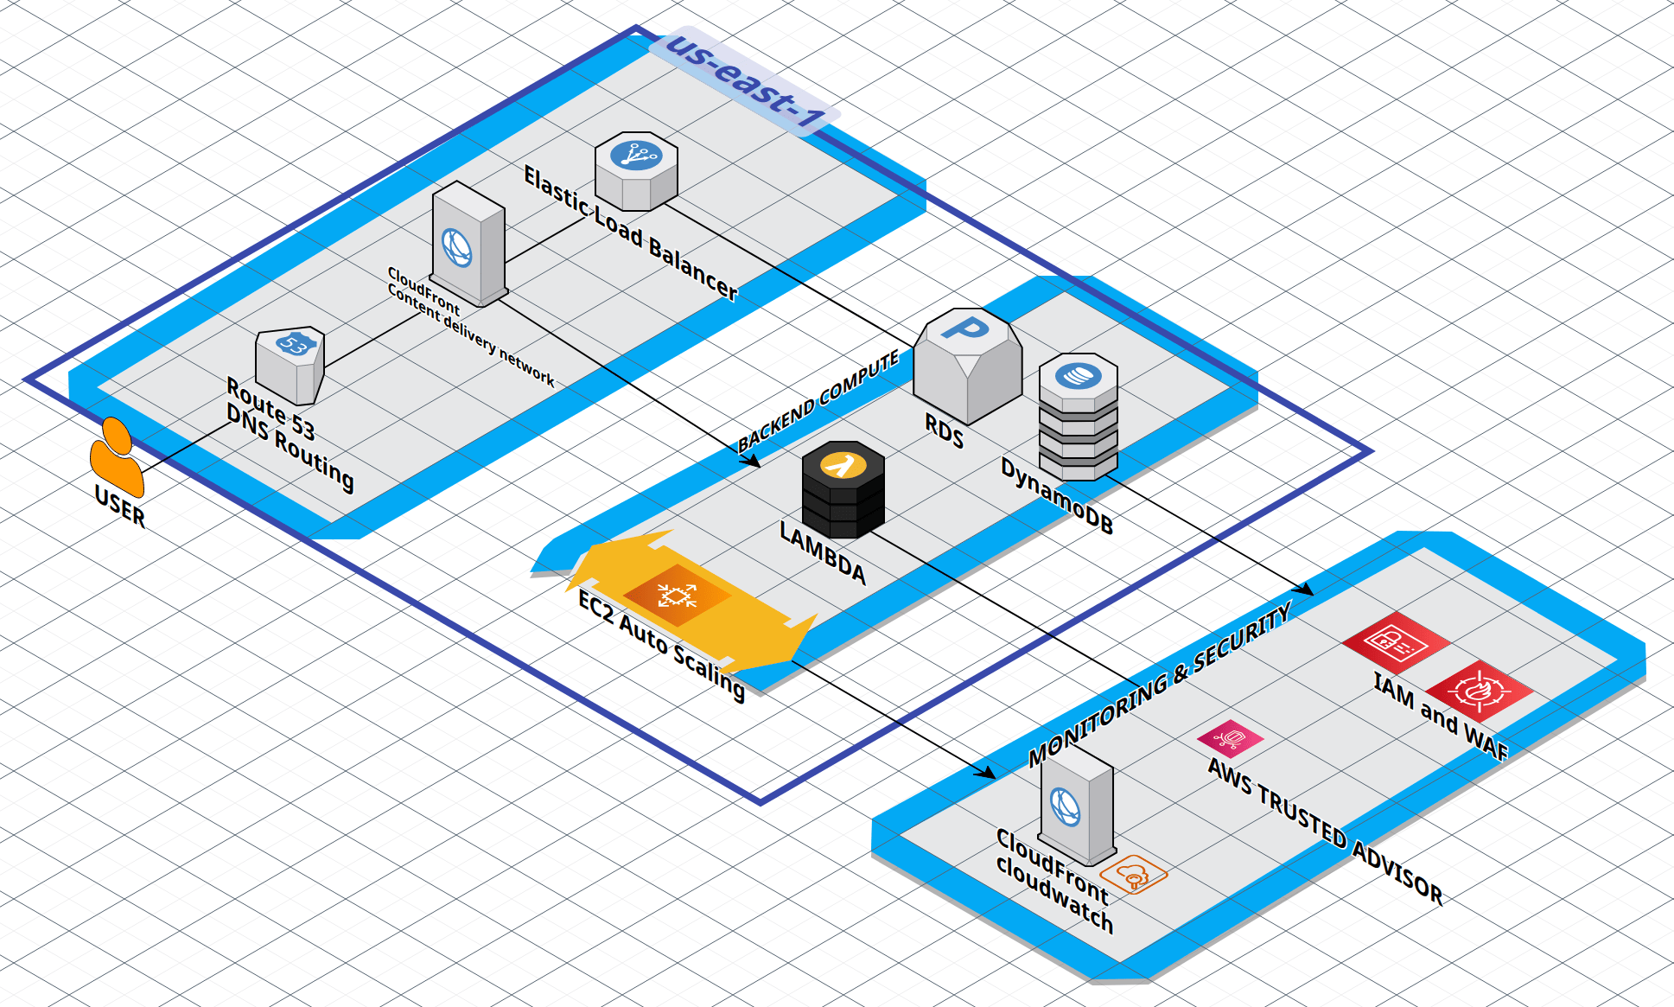

Slide 3


Contents
01
Overview
02
Architecture Components
03
AWS Service Choices and Rationale
04
Design Trade-Offs and Challenges

Slide 4
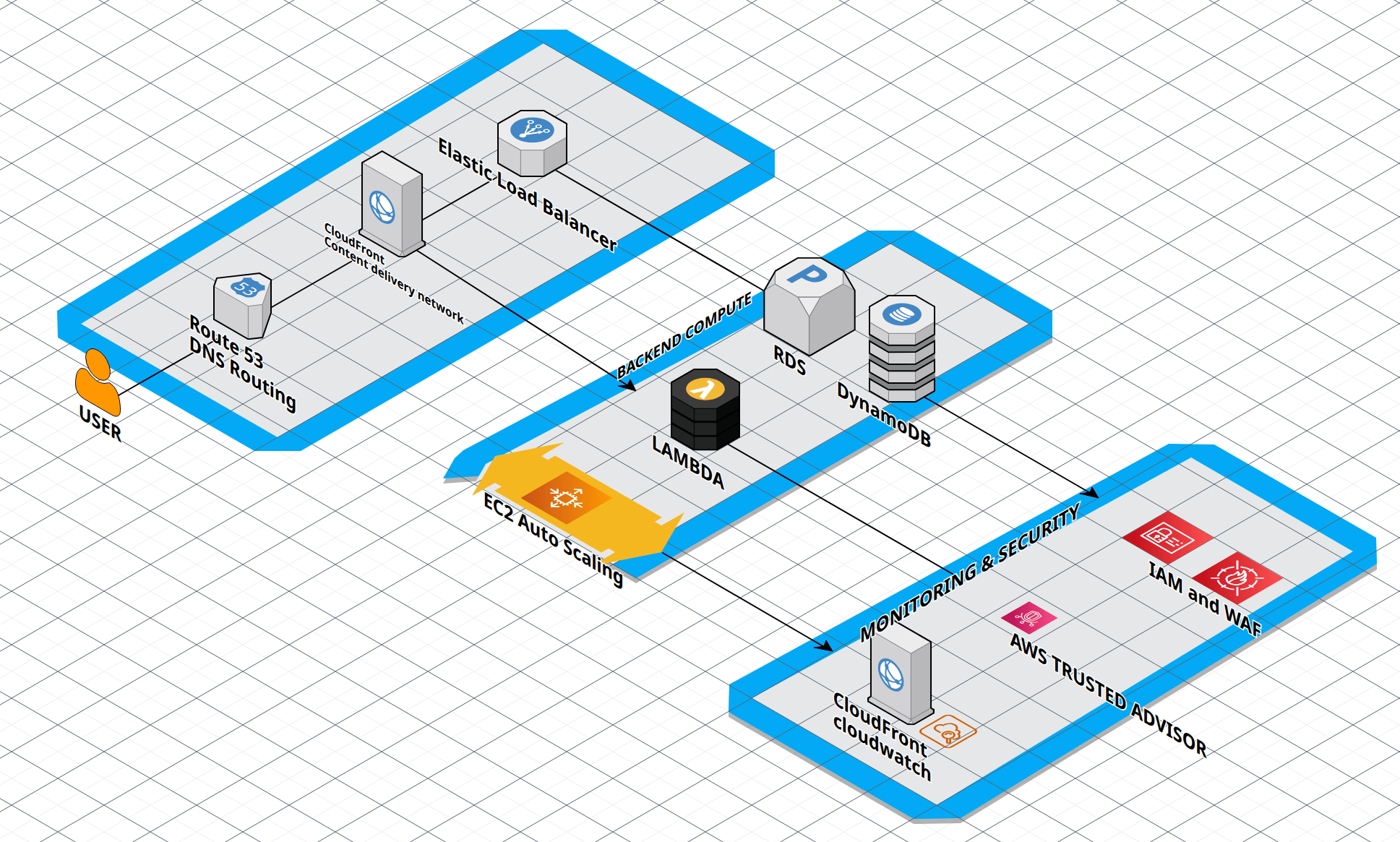
PART
01
Overview

Slide 5
Overview
Provides a detailed description of the AWS-based architecture designed for a 3D e-commerce platform, highlighting key services and their roles, rationale behind service choices, and the trade-offs involved in the design.

Slide 6
PART
02
Architecture Components

Slide 7
Users
Global accessibility
Users can reach the platform seamlessly via web or mobile devices, ensuring a wide and inclusive audience.
Optimized experience
The architecture ensures low latency for users regardless of their geographical location.
Cross-device support
The platform provides consistent performance and design adaptability across various screen sizes and device types.

Slide 8
Route 53
DNS management
Route 53 efficiently directs user requests, ensuring swift and accurate DNS resolution globally.
Nearest edge routing
High availability
Routes requests to the closest AWS edge location, reducing latency and improving the user experience.
Provides robust failover capabilities, ensuring uninterrupted service during outages.

Slide 9
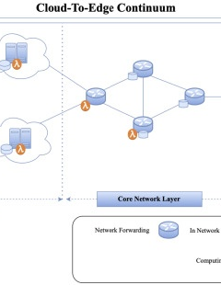
CloudFront (CDN)
Content caching
01
Stores and caches static assets such as 3D models, images, and JavaScript for improved delivery speeds.
Global distribution
02
Ensures that all content is distributed effectively to reduce latency for users worldwide.
Secure delivery
03
Employs HTTPS and integrates with AWS WAF to securely distribute assets and protect against web attacks.

Slide 10
Amazon S3
01
02
Durable storage
Scalable content delivery
Offers reliable storage for 3D models, textures, and other static content with 99.999999999% durability.
Seamlessly connects with CloudFront for high-speed retrieval of stored assets.
03
Cost-efficient
Utilizes lifecycle policies to transition older content to lower-cost storage tiers, optimizing costs.

Slide 11
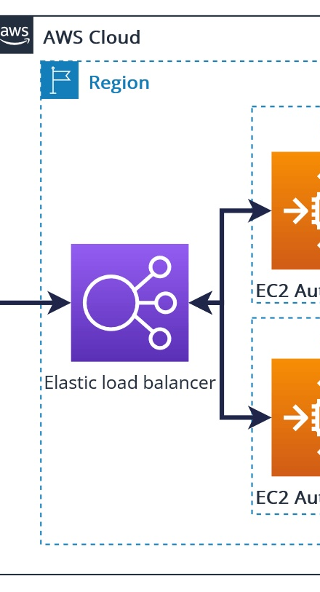
Elastic Load Balancer (ELB)
Traffic distribution
Directs incoming requests evenly among backend EC2 instances, ensuring balanced workloads.
Auto-scaling integration
Works in tandem with Auto Scaling to handle traffic spikes and maintain performance.
Fault tolerance
Operates across multiple availability zones (AZs), ensuring high availability and minimizing failures.

Slide 12
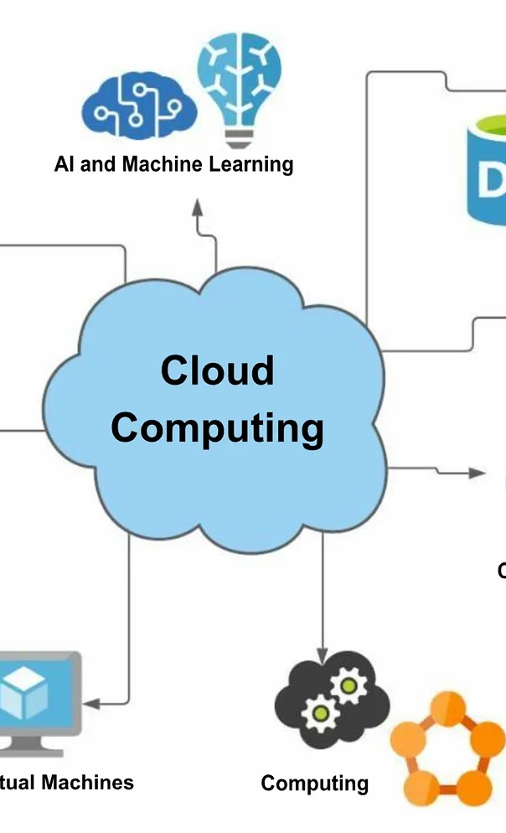
Backend Compute
EC2 for main application
Executes primary dynamic tasks such as managing user sessions and processing checkout workflows effectively.
AWS Lambda for serverless tasks
Performs on-demand image/video processing and thumbnail generation of 3D models, reducing server load.
Event-driven computations
Employs serverless processing for smaller, time-sensitive tasks, ensuring efficient resource usage.

Slide 13
Databases
Transactional storage with RDS
01
Relational databases like MySQL or PostgreSQL store critical data such as orders and payment history securely and reliably.
Fast catalog access with DynamoDB
02
Utilized to store product metadata and interaction data, enabling low-latency and scalable access.
Scalability and fault tolerance
03
Databases are configured for Multi-AZ deployments and automated backups to minimize data loss risks.

Slide 14
Monitoring & Security
Performance monitoring with CloudWatch
01
Tracks metrics such as application latency and error rates while triggering alerts for irregularities.
Continuous optimization with Trusted Advisor
02
Highlights inefficiencies in cost, performance, and security for constant improvement.
Access control with IAM
03
Defines granular access permissions, ensuring the principle of least privilege is enforced across the platform.

Slide 15
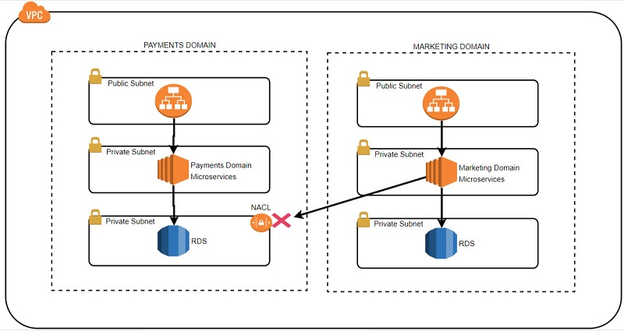
Monitoring & Security
Threat prevention with AWS WAF
Shields the application from web-based threats like SQL injection and cross-site scripting attacks.
Encryption implementation
Uses SSL/TLS protocols via CloudFront to ensure secure data transmission between users and the platform.

Slide 16
PART
03
AWS Service Choices and Rationale

Slide 17
High Availability
Leverages ELB to distribute incoming traffic across multiple EC2 instances and Availability Zones, ensuring that no single point of failure disrupts uptime.
Using Auto Scaling ensures that additional resources are automatically provisioned during high traffic periods, while scaling down during off-peak hours.
Multi-AZ RDS provides automatic failover capability for the relational database, ensuring database availability during unexpected outages.
CloudFront reduces latency by caching static assets globally, providing users with quick access to content from edge locations.

Slide 18
Scalability
Auto Scaling dynamically adjusts the number of EC2 instances according to traffic patterns, accommodating sudden spikes or reducing idle resources automatically.
AWS Lambda enhances scalability by managing event-driven workloads, such as image processing or creating 3D model thumbnails, without requiring pre-provisioned infrastructure.
DynamoDB offers horizontal scaling to handle increased read and write throughput for product catalog metadata and interaction data without performance degradation.

Slide 19
Point三
Performance
CloudFront accelerates content delivery by caching 3D models and static assets at edge locations near users, ensuring lower latency and faster load times.
Amazon S3 enables efficient storage and fast retrieval of static content such as 3D models, images, and textures, optimizing the end-user experience.
DynamoDB delivers low-latency, high-throughput performance for retrieving and updating product or user interaction data critical to platform responsiveness.

Slide 20
Security
IAM enforces a principle of least privilege, ensuring that users and systems only have access to the resources they truly need.
Security Groups act as a virtual firewall for EC2 instances, limiting inbound and outbound traffic based on fine-tuned security rules.
AWS WAF adds an extra layer of defense by blocking malicious web traffic and protecting the application from common attack patterns.
SSL/TLS encryption through CloudFront ensures the confidentiality and integrity of data in transit, safeguarding sensitive information exchanged between users and the platform.

Slide 21
Cost Optimization
AWS Lambda reduces operational costs by enabling developers to execute compute logic without maintaining idle servers, thus optimizing resource cost efficiency.
Auto Scaling prevents resource over-provisioning by constantly monitoring traffic patterns and allocating just enough resources during peak times.
AWS Trusted Advisor provides actionable insights to identify cost savings opportunities and alert administrators to eliminate unnecessary expenses.
S3 lifecycle policies optimize storage costs by automatically transitioning outdated assets to more affordable, long-term storage classes.

Slide 22

PART
04
Design Trade-Offs and Challenges

Slide 23
EC2 vs. Lambda
Complex backend task suitability
EC2 excels at handling heavy computation and complex backend tasks, such as managing user sessions or checkout processes, but can become expensive during periods of low traffic.
Serverless efficiency
AWS Lambda offers a cost-efficient solution for processing tasks like image rendering or generating thumbnails, as it eliminates idle server costs. However, it has constraints in execution time and memory, making it less suitable for intensive 3D computations.

Slide 24
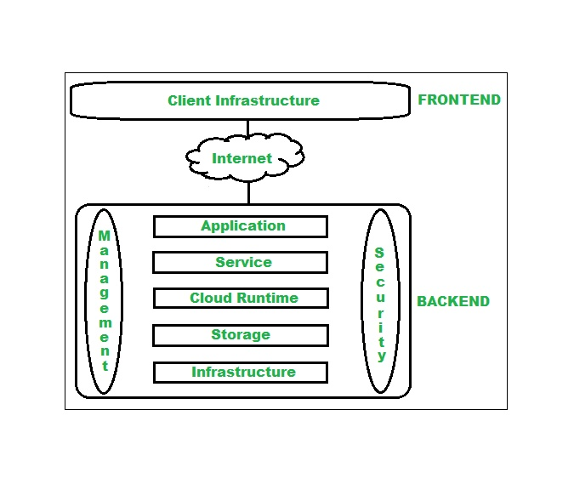
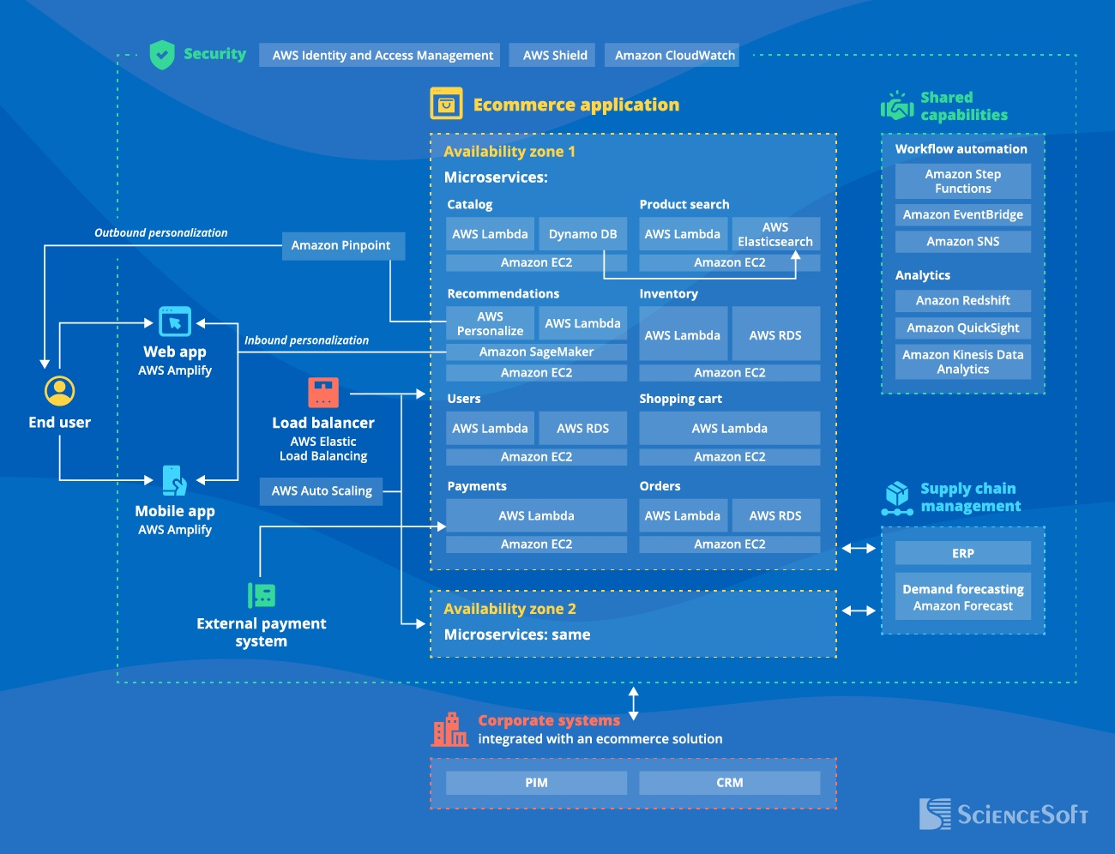
EC2 vs. Lambda
Scaling for workloads
Lambda automatically scales with demand, ensuring micro-tasks are effectively handled, while EC2 relies on Auto Scaling to manage traffic fluctuations for backend workloads.
Cost considerations
EC2 requires continuous provisioning, sometimes leading to underutilization, whereas Lambda operates on a pay-per-use model, reducing wastage of resources.

Slide 25
”
Transactional workload management Amazon RDS, equipped with MySQL or PostgreSQL engines, is optimized for transactional processing such as orders and payments history, offering robust consistency and reliability. High-speed access for independent data DynamoDB shines in delivering low-latency, horizontally scalable metadata queries, ideal for product catalogs and user interaction records, though it may compromise consistency in complex queries. Scalability differences RDS scales vertically, giving limited expansion options, unlike DynamoDB’s horizontal scaling, which effectively handles growing datasets without bottlenecks.
RDS vs. DynamoDB

Slide 26
RDS vs. DynamoDB
“
Cost and operational efficiency RDS incurs higher operational costs due to failover and database administration needs, whereas DynamoDB offers cost-effective serverless operation with minimal maintenance.

Slide 27
Global Delivery
Efficient asset distribution
Challenges in asset updates
Integration with S3
Scalability for spike management
AWS CloudFront accelerates global delivery of static assets like 3D models and images, ensuring low-latency customer experiences across regions.
Frequent updates to 3D assets trigger cache invalidation processes, adding operational complexity and potentially slowing down delivery for the latest assets.
Using CloudFront with Amazon S3 ensures seamless delivery of stored 3D content, enhancing reliability and performance in asset management.
CloudFront manages traffic spikes efficiently through its edge caching, ensuring uninterrupted availability during promotional events or peak demand periods.

Slide 28
Monitoring Complexity
Designing effective alerts: Crafting targeted CloudWatch alerts for traffic surges or errors in rendering 3D assets requires a deep understanding of workload patterns and error types.
Metric tracking: CloudWatch provides detailed performance metrics, but correlating them to actionable insights for complex platform behaviors remains a challenge.
Error detection in rendering tasks: Monitoring for anomalies in computational tasks, such as 3D rendering errors or thumbnail generation, needs meticulous configuration of triggers and alarms.
Enhanced visibility with Trusted Advisor: Using AWS Trusted Advisor a1ongside CloudWatch ensures recommendations for performance and security refinement in monitoring strategies.

Slide 29

Thank you

